Slide 1
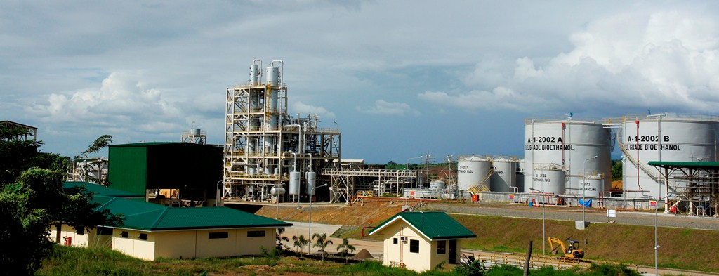
Empirical Evidence on Determinants of Biofuels Production: Implications For Developed and Developing Economies
2017 EASTERN REGIONAL ORGANIZATION FOR PUBLIC ADMINISTRATION (EROPA)
September 11-15, 2017
Grand Intercontinental Parnas Hotel, Seoul, South Korea
John Paul D. Antes
Sugar Regulatory Administration
Philippines

Slide 2
Contents
Background
Biofuel in a Nutshell
Literature Review
Scope and Limitations
Research Hypotheses
Data Set, Methodology and Model Specification
Empirical Evidence and Interpretations
Insights and Recommendations
Further Research and Study

Slide 3
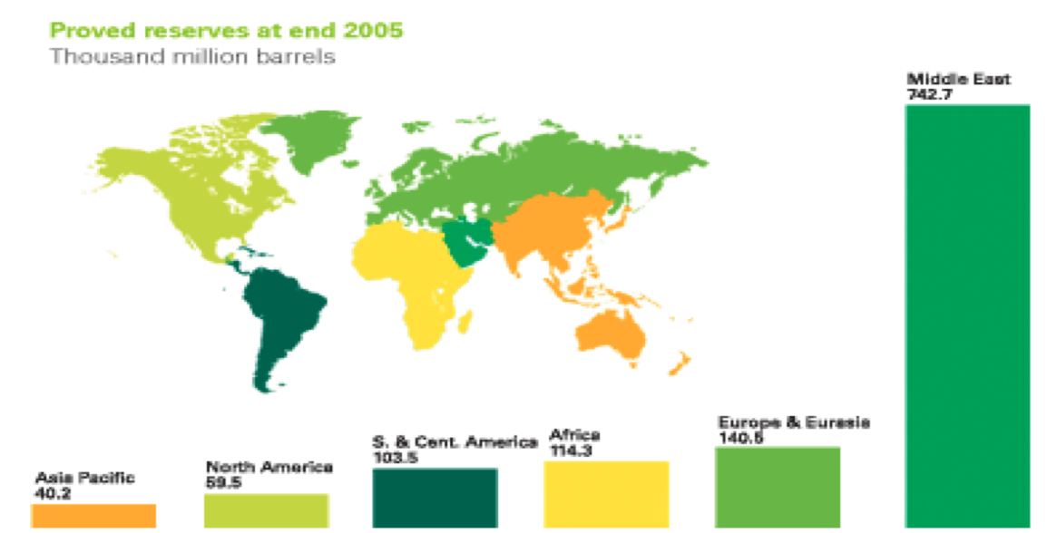
Background
According to the International Energy Agency, it is expected that between 2003 and 2030 the world consumption of marketed energy will escalate by 71%, with Asia nearly tripling its energy needs.
There is imbalance in distribution of proved oil reserves among the regions. Records show that at the end of 2005 the highest concentration of proved oil reserves was in the Middle East with 742.7 thousand million barrels while the lowest concentration was in the Asia Pacific region with only 40.2 thousand million barrels

Slide 4
Biofuel in a Nutshell
Biofuel is defined as “any fuel that is derived from organic matter.” The fuel is made from biomass and primarily used for transport consumption and power generation.
The International Energy Agency explains that there are different types of biofuels, biofuel feedstock, and conversion technologies:
First Generation
Second Generation
Third Generation
Fourth Generation

Slide 5
Literature Review
A recent paper attempted to analyze the determinants of biofuel production. As a result of that research, five key macro-level factors were initially identified (Chang et al. 2010):
gross national income (GNI),
agricultural land (AGR),
share of renewable energy (SRE) out of total primary energy supply (TPES),
carbon dioxide (CO2) emissions, and
poverty rate

Slide 6
Literature Review
The initial method of biofuel production function is as follows:
LQBIO_{t} = C + α1LAGL_{t} + a2LGNI_{t} + α3LSRE_{t} + α4LCO2_{t} - α5LPOV_{t} + e_{t}
Where:
QBIO = refers to the production of biofuel
AGL = refers to the area of agricultural land (+)
GNI = refers to the world gross national income (+)
SRE = refers to the share of renewable energy out of total primary energy supply (+)
CO2 = refers to carbon dioxide emission (+)
POV = refers to poverty rate (-) L = logarithmic function
C = is a constant (+) t = year (1981-2006)

Slide 7
Literature Review
Applying the model using ordinary least squares (OLS) regression, a new biofuel production function criterion emerged as follows:
LQBIO = -5.19 + 4.641LAGL - 3.06LGNI + 0.78LSRE + 8.07LCO2 +
4.04LPOV + e
With the exception of SRE-TPES, results of the regression analysis illustrated that the other determining variables were statistically significant: agricultural land, CO2 emissions, and poverty rate all had positive correlations to the production of biofuel; GNI had a negative relation to biofuel.

Slide 8
Literature Review
In 2007 and 2008, according to Quarter Reports on Biofuels Country Attractiveness Indices released by Ernst and Young, Brazil and the United States continue to lead the drive towards the development and utilization of biofuels in the global market.
Other countries included are Canada, Colombia, France, Germany, Italy, Netherlands, Spain, Sweden, the United Kingdom, China, India, Indonesia, Malaysia, the Philippines, and Thailand.

Slide 9
Literature Review
Using 10 years of national data (from 2000 to 2009) from the top 17 biofuel producing countries, the researcher adopts three of the five identified determinants: gross national income, agricultural land, and CO2 emissions.
The omission of SRE-TPES as a determining factor is due to Chang’s findings that its correlation to biofuel production was insignificant. Poverty rate is also excluded as a variable because Chang’s data includes the underdeveloped economies like the countries of the sub-Saharan Africa region.

Slide 10
Literature Review
The researcher proposes the addendum of foreign direct investment (FDIs) as well as research and development (R&D) as the determinants of biofuels production.
FDIs in biofuels are now increasing, the biggest recipient is Brazil. Malaysia, the world’s largest palm oil producer, is also attracting numerous investors for the development of biofuels. China is also venturing into the biofuels industry.

Slide 11
Scope and Limitations
This study concentrates only on the top 17 biofuel producing nations appearing as leaders in the 2007 and 2008 Biofuels Country Attractiveness Indices commissioned by Ernst & Young. These countries have existing markets, infrastructures, and legal frameworks that support the development and utilization of renewable biomass energy, particularly the bioethanol and biodiesel fuels, which use sugars, starches, or vegetable oils for fuel additives.

Slide 12
Research Hypotheses
In view of the foregoing, this paper attempts to identify the determinants of biofuels production and substantiate the following research hypotheses:
Hypothesis 1: The available acreage of agricultural land has a positive effect on biofuel production in both developed and developing economies. Farmers tend to allocate more agricultural land to grow more biofuel feedstock. Hence, increasing the land allocation for biofuel crops plantation will increase biofuel production (Chang et al., 2010).

Slide 13
Research Hypotheses
Hypothesis 2: GNI has a positive effect on biofuel production in both developed and developing economies. As household income increases so does the demand for energy in all likelihood increases. As a result, there is a tendency for energy demand to exceed the current oil supply, which will in turn increase the need for alternative sources of energy such as biofuel (Chang, 2010).
Hypothesis 3: The level of CO2 emissions has a positive effect on biofuel production in both developed and developing economies. Environmental concerns particularly carbon dioxide reduction in the air, has become the motivating factor leading to increased production of biofuel (Jennings, 2009).

Slide 14
Research Hypotheses
Hypothesis 4: Foreign Direct Investment (FDI) has a positive effect on biofuel production in both developed and developing economies. Net inflows of investment to finance the exploration and development of sustainable energy would provide enormous benefits in the form of foreign business capital, business and wages improvement, the “crowding in” effect, and new technologies. At the same time, the production of biofuels would increase that much more on a global scale (Dudáš, n.d.).
Hypothesis 5: Research and Development (R&D) has positive effect on biofuel production in both developed and developing economies. Intense R&D has been conducted to develop technologies that improve conversion efficiency, identify sustainable feedstock and upgrade cost-effective conversion methods for next generation biofuels (FAO, 2008).

Slide 15
Data Set, Methodology and Model Specification
Data Set
The variables used for empirical analysis are secondary quantitative data derived from the reports and studies conducted by such international organizations as
the World Bank
the International Monetary Fund
the Asian Development Bank
the U.S. Energy Information Administration and
the United Nations Food and Agricultural Organization

Slide 16
Data Set, Methodology and Model Specification
Methodology
panel data analysis is employed to explain the effects of independent variables on the growth of biofuel production.
Using the SPSS software, the author initially ran the General Linear Model (GLM) to analyze the panel data.
However, after fitting the GLM, the results suggested that the residual errors were strongly correlated.

Slide 17
Data Set, Methodology and Model Specification
Model Specification
The dependent variable is total biofuels production.
Independent variables are: availability of agricultural land (% of land area), gross national income (in US$), carbon dioxide emission (in Million Metric Tons), foreign direct investments (in US$), and research and development (% of GDP).
Level of development serves as a dummy variable, which allows us to compare the results for developed and developing economies.

Slide 18
Data Set, Methodology and Model Specification
Model Specification
The new empirical model on the relationship between total biofuels production and the determinant variables is represented as:
LTBP_{t} = ß₀+ß1LAGR_{t}+ß2LCO2_{t}+ß3LGNI_{t} + ß4LFDIs_{t} + ß5LRD_{t} + ß 6LevelofDev + ß7(LevelofDev*LCO2t ) +
ß8(LevelofDev *LGNI_{t} )+ ß9(LevelofDev *LFDIs_{t} ) + ß10(LevelofDev *LRD_{t} ) + ß11Years + e_{t}

Slide 19
Data Set, Methodology and Model Specification
Model Specification
where:
LTBP_{t} = refers to the logarithm of total biofuels production
ß₀ = refers to grand mean of the model or the intercept
Xn_{t} = refers to the log-transformed set of covariates
LevelofDev is a dummy variable, where LevelofDev = 0, denotes a
developing economy and LevelofDev = 1, denotes a developed economy
LevelofDev*Xn_{t} = a term representing the interaction of transformed
covariates with the level of development
t = time (years)
e_{t} = error

Slide 20
Empirical Evidence and Interpretations

Slide 21
Empirical Evidence and Interpretations
Table 2 shows a comparison of results between the two types of AR(1) covariance structures. AR(1) yields only one significant variable, LCO2. The rest of the explanatory variables, including the interactions, appear to be insignificant.
On the other hand, AR(1):Heterogeneous yields numerous significant explanatory variables: intercept, LCO2, LGNI, Level of Development, and the interaction between Level of Development and LGNI.
AR(1):Heterogeneous also has a lower value of AIC. As a result of the comparison, the overall model using AR(1):Heterogeneous covariance structure is the preferred model.

Slide 22
Empirical Evidence and Interpretations

Slide 23
Empirical Evidence and Interpretations
Empirical evidence suggests that environmental concerns appear to be the primary motivation behind the exploration and development of biofuels. That is, the increase of carbon dioxide emissions in the air is leading to biofuel production growth.
GNI is also a significant determinant of biofuel production in both developed and developing economies. However, the effect of GNI on biofuel production for developed economies differs significantly from biofuel production in developing economies.

Slide 24
Empirical Evidence and Interpretations
The regression result for agricultural land suggests that this explanatory variable is not a significant determining factor of biofuels production.
Empirical evidence suggests that foreign direct investment is likewise not a determinant of biofuel production.
Research and development appears to be not a sufficient determinant to explain the production of biofuels.

Slide 25
Insights and Recommendations
Identifying the determinants of biofuels production and using the data of selected countries that are considered to be pioneers in the production of biofuels may help facilitate the creation of more effective and efficient biofuels policies formulation. This would be from the macro level perspective and involving as well strategies in micro level management that would eventually contribute in major ways to the growing industry of green energy.

Slide 26
Insights and Recommendations
The following insights and recommendations are enumerated:
Cooperation between the developed and developing economies.
A country’s strong commitment to biofuels development depends upon the quality of its legal framework.
Fostering and strengthening Public-Private Partnerships.
The importance of R&D
Food security and land degradation
Build Quality Assurance

Slide 27
Further Research and Study
The limitations of the data used for regression analysis due principally to missing values, particularly R&D data, may render the overall results of the research paper somewhat inconclusive.
If the study is to be conducted again, there would be the need to collect more and complete data, which would increase the chances of obtaining more accurate results.
It would also be better to include underdeveloped economies such as the countries of Sub-Saharan Africa, to transform this study into an effective, global scale work.

Slide 28
THANK YOU FOR LISTENING
Empirical Evidence on Determinants of Biofuels Production: Implications For Developed and Developing Economies
John Paul D. Antes, MA IBDS, MPA
Sugar Regulatory Administration
Philippines
jpublic.ad@gmail.com

