Slide 1
Challenges of Sharing Ambiguous Goals Institutional arrangements to ensure multi-stakeholder partnership for the SDGs
Eunju KIM
Korea Institute of Public Administration
E-mail: eunjukim@kipa.re.kr

Slide 2
Introduction
Constructive and Deconstructive Ambiguity of the SDGs
Challenges to Implement Ambiguous SDGs at the National Level
Institutional arrangements from the perspective of
multi-level governance
Conclusion

Slide 3
Introduction

Slide 4
1. Introduction
SDGs vs. MDGs
How can the SDGs be implemented at the national level?
What are the challenges that nation states face in practice?
How can we ensure effective and inclusive institutional arrangements to ensure partnership?

Slide 5
2. Constructive and Deconstructive Ambiguity of the SDGs

Slide 6
2. Constructive and Deconstructive Ambiguity of the SDGs
2.1 Constructive Ambiguity of international agreements
“Constructive Ambiguity”: positive aspect of highly comprehensive set of ambitious international goals
Leaves room for consensus building among nation states with a wide-ranging spectrum of political interests
Specific design of national implementation policies is left to each nation state
Complicated negotiation of the SDGs (2012-2015) among member states, NGOs and international organisations
Various goals from economic, social and environment agenda

Slide 7
2. Constructive and Deconstructive Ambiguity of the SDGs
2.2 Deconstructive Ambiguity of international agreements
Lack of strong accountability
Means of enforcement: mostly moral sanctions and peer pressure
Confusion or competition when determining policy priorities from a wide spectrum of goals and targets
Ambiguous goals may lead to ambiguous means, giving way to opposing interpretations as to which social groups should receive policy support
Categorized into Ambiguity of priority, policy means, target population and evaluative standards

Slide 8
2. Constructive and Deconstructive Ambiguity of the SDGs
Definitions of Ambiguity and expected problems in practice
Ambiguity | Definitions | Expected problems in practice
Priority | Competitive interpretative of goals Different views on importance of goals | Polysemy of goals Uncertainty of priority among many goals Confusion and uncertainty of planning
Policy Means | Unclear policy tools | Difficulties of establishing law and institutions Conflict of interest among institutions
Policy Target | Unclear policy targets | Conflict of relevant institutions Uncertainty of target group
Evaluation | Competitive interpretation of goal achievement and progress Difficulties of quantification | Inadequacy of monitoring results Dependency on quantifiable indicators

Slide 9
3. Challenges to Implement Ambiguous SDGs
at the National Level

Slide 10
3. Challenges to Implement Ambiguous SDGs at the National Level
3.1. Data and Method
Face-to-face in-depth interview (15 interviewees)
Academics in international development and sustainable development; public officials in central government and local government who have duties of the SDGs or sustainable development; members of civil society organisations
MAXQDA software analysis
Theoretical coding scheme
Open coding scheme

Slide 11
3. Challenges to Implement Ambiguous SDGs at the National Level
3.2 Voices from the field: Difficulties due to ambiguous goals
Difficulties in policy planning and priority-setting
Two approaches to the SDGs: a follow-up of the MDGs (international development) vs. a comprehensive international norm (encompasses environmental, economic and social issues)
Difficulties in structuring plans for national implementation due to vast scope of the goals
The need to define a strategic sub-set of the SDGs, or ‘Korean SDGs’
“We need to select targets that we can implement, or those we need to implement. If there are 169 targets overall, let’s say we can control about 3-40 targets. But if we think we need to do all of them, then that’s when it becomes difficult. So we need to understand exactly where we’re at and make quick decisions about which department will do, or not do, this or that.” (Government Official E, 2017.3.17.)

Slide 12
3. Challenges to Implement Ambiguous SDGs at the National Level
3.2 Voices from the field: Difficulties due to ambiguous goals
Fragmentation in establishing institutions
Ministry of Foreign Affairs
Ministry of Environment
Sustainable Development Committee

Slide 13
3. Challenges to Implement Ambiguous SDGs at the National Level
3.2 Voices from the field: Difficulties due to ambiguous goals
Limitation of governance structure which is led by single Ministry
“When the Ministry of Environment wants to hold a meeting with other government departments they just can’t on their own. Other departments ask ‘why is the Ministry of Environment talking about women’s rights and poverty?’ The SDGs cover a lot of areas so meetings are generally held together with the Office of Government Policy Coordination.” (Government Official F, 2017.03.17)

Slide 14
3. Challenges to Implement Ambiguous SDGs at the National Level
3.2 Voices from the field: Difficulties due to ambiguous goals
Multi-stakeholder partnership among - Relevant Ministries; - Civil Society; - Central – Local government
“Clauses regarding civic participation should be included in the Sustainable Development Act. Even if some offer advice as external consultants there should be more active participation in the actual drafting, policy evaluation and management. And we need to rely on them more. The Ministry of Environment can’t do everything alone. They are only the coordinators. That’s why the SDGs need structure.” (Professional L, 2017.5.31.)

Slide 15
3. Challenges to Implement Ambiguous SDGs at the National Level
3.2 Voices from the field: Difficulties due to ambiguous goals
“Adaptive implementation” (Berman 1978) of the SDGs:
Adoption of a certain policy does not mean that the original intention of macro-level leadership is automatically passed down to executors at the micro-level
No separate national implementation plan after finalization of the SDGs
Most goals and targets are being implemented in connection with existing policies
Policy officers also tend to observe the SDGs from the viewpoint of existing policy projects and develop plans for improvement accordingly

Slide 16
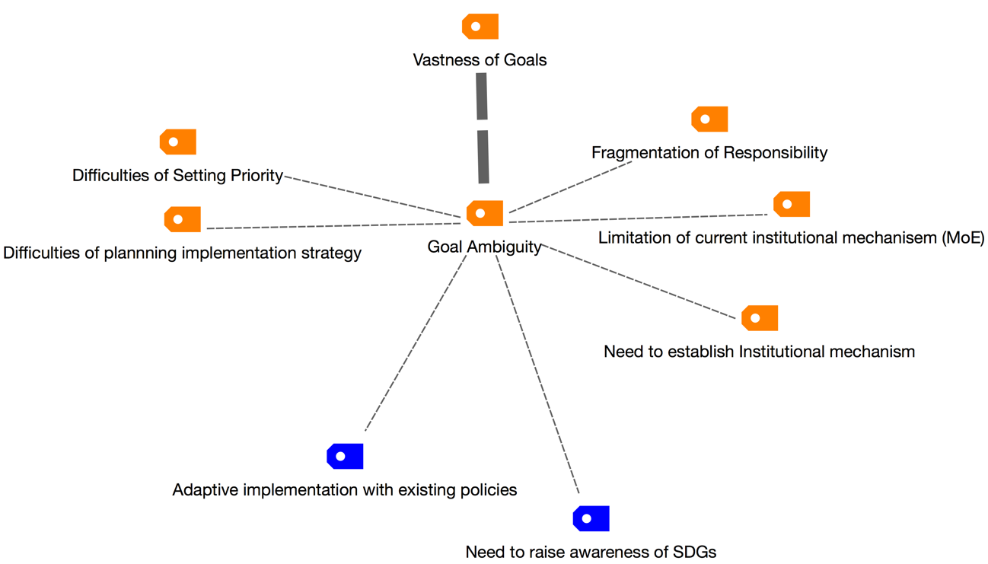
3. Challenges to Implement Ambiguous SDGs at the National Level
Mapping of Contents Analysis

Slide 17
4. Institutional arrangements from the perspective of multi-level governance

Slide 18
4. Institutional arrangements from the perspective of multi-level governance
4.1 Horizontal Dimension: Inclusive between public, private and civil society
Horizontal coordination structure: ‘Center of Government’ stands at the center of the SDGs implementation and cooperates with other departments.
Sustainable Development Committee: formed under the Office of Policy Coordination or the President, with roles, authority and accountability of implementing the SDGs and policy coordination
Institutional arrangements for partnerships with diverse stakeholders
Innovative measures to increase awareness and participation of the SDGs among citizens

Slide 19
4. Institutional arrangements from the perspective of multi-level governance
4.2 Vertical Dimension: International-National-Local government
Applying existing institutions (ex: ‘Local Agenda 21’) could be an efficient solution to implementing the SDGs at the local level
Further efforts to strengthen ties between central and local level implementation of the SDGs (ex: mid-2000s, presidential Sustainable Development Committee)
From the central government to local governments:
Consultation (ex: standard guidelines for local ordinances)
Resources on best practice, such as examples of local governments that are proactively applying and implementing the SDGs

Slide 20
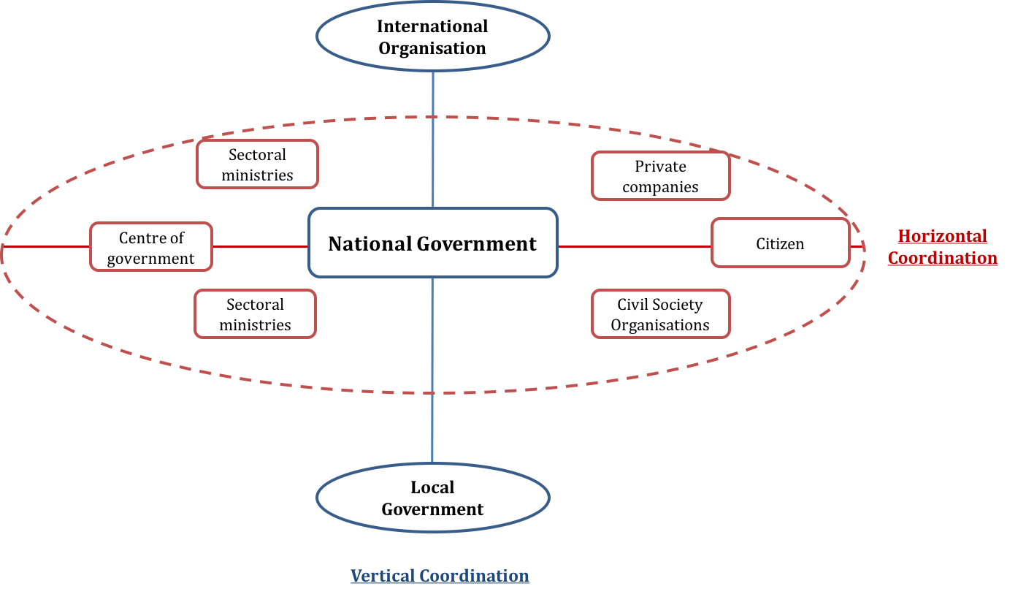
Horizontal and Vertical Coordination for the SDGs
4. Institutional arrangements from the perspective of multi-level governance

Slide 21
5. Conclusion

Slide 22
5. Conclusion
Vastness of the SDGs (17 goals and 169 targets) may lead to “Goal ambiguity”, the “SDGs Label" on existing policies, lack of in-depth understanding of the SDGs
Policy recommendations
National implementation system which will ensure that accountability of the SDGs
Horizontal and vertical dimension of multi-level governance
‘Centre of Government’ as core coordinating agency
Role of local government is critical
Using existing institutional mechanism BUT need new approach

Slide 23
Thank you

