Slide 1
Building e-resilience
The role of ICTs in DRM in the PHILIPPINES
Prepared by: E. Alampay, A. Panao, and R.Rye

Slide 2
Background
This paper looks at the issue of e-resilience in the Philippines, and evolving national perspectives on the issue.
The paper provides a country-level synopsis based on the ICT readiness of the national DRM plans and the resilience of ICT systems to provide basic services in withstanding disaster events and help in recovery.

Slide 3
Disaster
A serious disruption of the functioning of a community or a society involving widespread human, material, economic or environmental losses and impacts, which exceeds the ability of the affected community or society to cope using its own resources.
Natural or Man-made (i.e. terrorism)

Slide 4
Disaster Risk
Disaster risk is a combination of potential hazards, existing vulnerabilities, and capacities to cope with a disaster event.
A disaster occurs when a vulnerable community is exposed to a hazard (e.g. flood, earthquake, typhoon) and is unable to cope with the impact.

Slide 5
DRM Defined
Disaster Risk Management (DRM) is a set of processes to lessen the impacts of disasters on society.
This process involves the development of policies, strategies and capacities, among other activities, to assess, prepare for and reduce disaster risks, before a disaster strikes.
DRM cycle
Disaster Prevention & Mitigation
Disaster Preparedness
Disaster Response
Disaster Recovery

Slide 6
ICT Defined
Information and Communications technology (ICT) are basically information handling tools—a varied set of goods, applications and services that are used to produce, store, process, distribute and exchange information.
i.e telephone, internet, mobile technology, computing

Slide 7
ICT relevant to DRM
Access to reliable, accurate and timely information at all levels of society is crucial immediately before, during, and after a disaster.
Information becomes knowledge of disaster risk through a learning process, and timely and properly applied knowledge turns into practical activities on the ground.

Slide 8
E-Resilience
Resilience - ‘ability to recover after a disaster as quickly as possible’
“the ability of a system, community, or society exposed to hazards to resist, absorb, accommodate to, and recover from the effects of a hazard in a timely and efficient manner, including through the preservation and restoration of its essential basic structures and functions” (UNISDR 2009, 24).
E-Resilience - ICTs role in DRM. Addresses not only software, and hardware, but also the communication aspect, and its ability to operate and recover during and after disasters

Slide 9
Context
According to a United Nations report, countries in Asia and the Pacific are more prone to disasters than those in other parts of the world
40 per cent of the 3,979 disasters that occurred globally between 2005 and 2014
Almost 60 per cent of the total global deaths related to disasters and severe economic damage (45 per cent of global total damages).
The Philippines is the 3rd most disaster prone country in the world.

Slide 10
PART I LEGAL AND POLICY CONTEXT for drm
Risk Reduction and Management as a Legal Duty
The state has committed to “provide maximum care, assistance, and services to individuals and families affected by disaster, implement emergency rehabilitation projects to lessen the impact of disaster and facilitate the resumption of normal social and economic activities.” Sec. 2 RA 10121
Legal context of DRM in the Philippines
Philippine Disaster Act of 2010 (RA 10121)
Climate Change Act of 2009
People’s Survival Fund Act
Risk Reduction and Preparedness Equipment Protection Act

Slide 11
DRM laws & icts
Policy | Provides for | ICTs involved
RA 10121 (Philippine Disaster Act of 2010) | multi-stakeholder participation in the development, updating, and sharing of a DRRM Information System | Database or information system GIS -based national risk maps
 | early warning and emergency alert system to provide accurate and timely advice | digital & analog broadcast, cable, satellite TVand radio, and wireless and landline communications
RA 9729 (Climate Change Act of 2009) | R & D, database development, and information dissemination | database, new risk assessment technology communication infrastructure
 | Research, development, and promotion of technology | - tools and technology relevant to climate change
RA 10174 (People’ Survival Fund Act) | financing the development of forecasting and early warning systems | - forecasting and early warning ICT
RA 10344 (Risk Reduction and Preparedness Equipment Protection Act) | Punishes the theft, destruction, tampering, or illegal selling (fencing) of equipment used in risk reduction and prevention (e.g. aRQ) | - government equipment and technology used in disaster reduction and management (e.g. tsunami warning and monitoring system).

Slide 12
ROLE OF LOCAL GOVERNMENT
Local Government units are expected to be at the forefront of emergency measures
Enshrined in the local government code
Reiterated in the Climate Change Act and Philippine Disaster Act
Municipal and city governments, for example, are expected to consider climate change adaptation as part of their official function
Barangays are mandated to be involved with municipal and city governments in raising climate change concerns and implementing solutions
Provincial governments, for their part, are to provide technical assistance and information on climate change action plans
Expected to be first responders and proactive in DRM activities

Slide 13
KEY INSIGHTs
DRM policies and programs have been progressively evolving.
Regulatory framework is developed but is hampered by weak implementation. Programs do exist but are not uniformly implemented
ICT for DRM is recognized in policy but is poorly supported and implemented in programs

Slide 14
Part 2 ict readiness and drm plans
The concept of e Resilience
State of ICT Infrastructure
Existing ICT activities relevant to DRR
Programs and initiatives that enhance DRR

Slide 15
E-Resilience
Resilience - ‘ability to recover after a disaster as quickly as possible’
“the ability of a system, community, or society exposed to hazards to resist, absorb, accommodate to, and recover from the effects of a hazard in a timely and efficient manner, including through the preservation and restoration of its essential basic structures and functions” (UNISDR 2009, 24).
E-Resilience - ICTs role in DRM. Addresses not only software, and hardware, but also the communication aspect, and its ability to operate and recover during and after disasters

Slide 16
Access to ICTs in the Philippines (2000-2013)

Slide 17
STATE OF BROADBAND ACCESS (SOURCE: broadband commission 2016)
Internet Access Indicator | Percentage
Access to fixed Broadband | 2.6
Access to wireless broadband | 20.3
Households with Internet | 32
Individual Access to the Internet | 47.8
Text capital of the world : I billion text sent messages a day
Rank 8th in the world in terms of facebook users

Slide 18
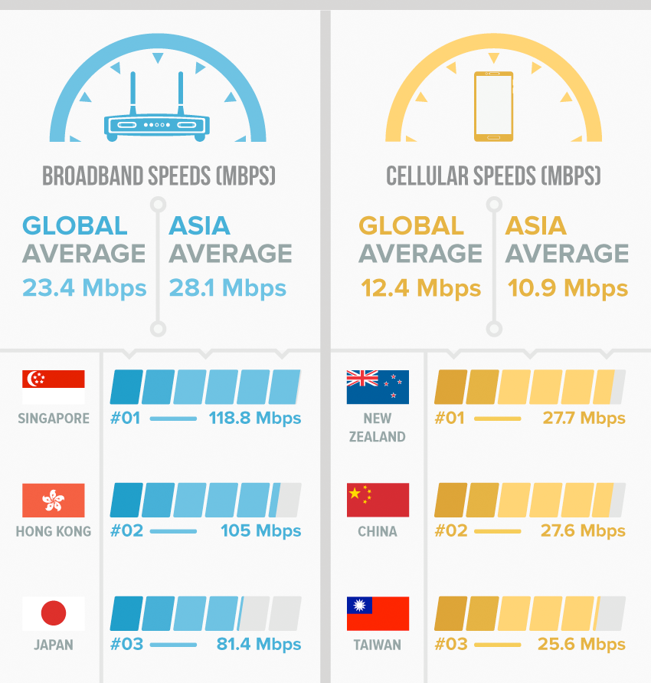
OOKLA’S NET INDEX

Slide 19
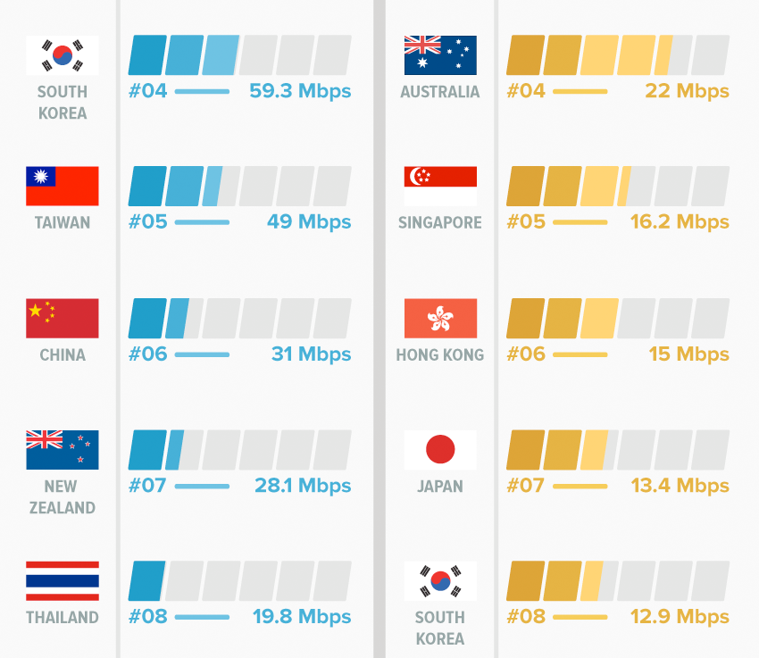

Slide 20
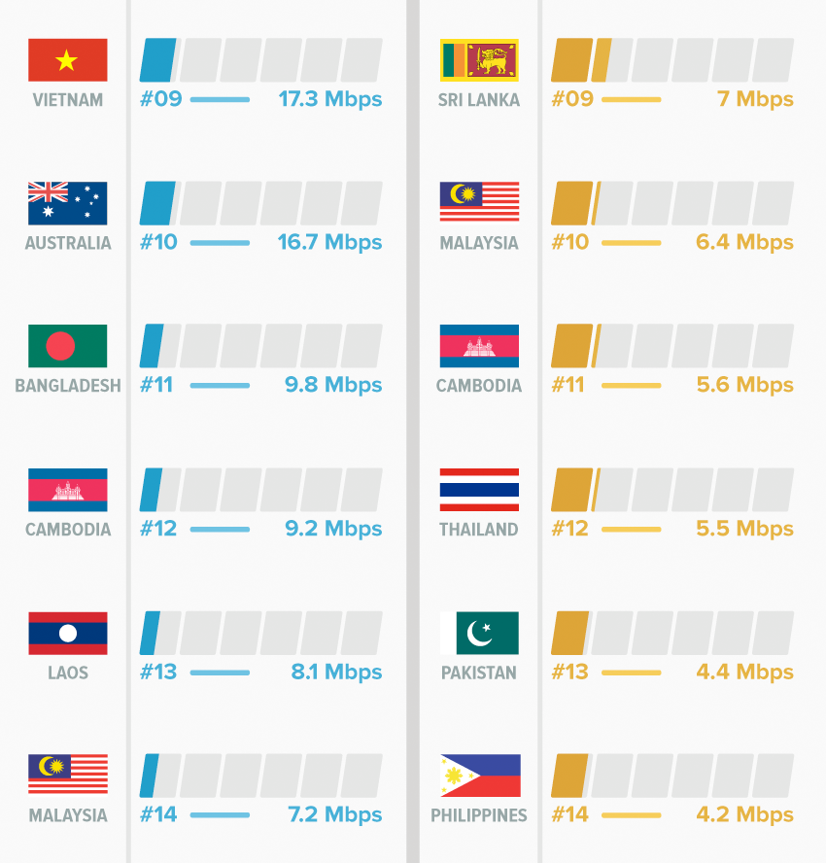

Slide 21
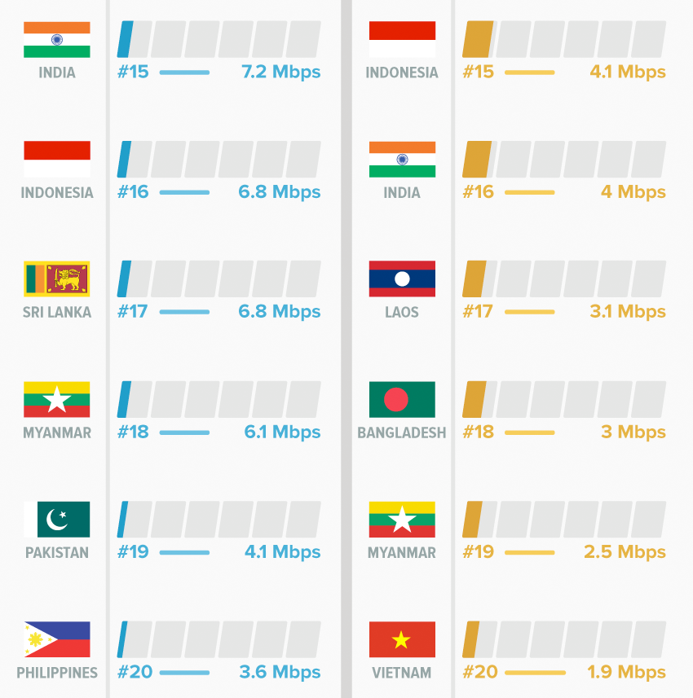

Slide 25
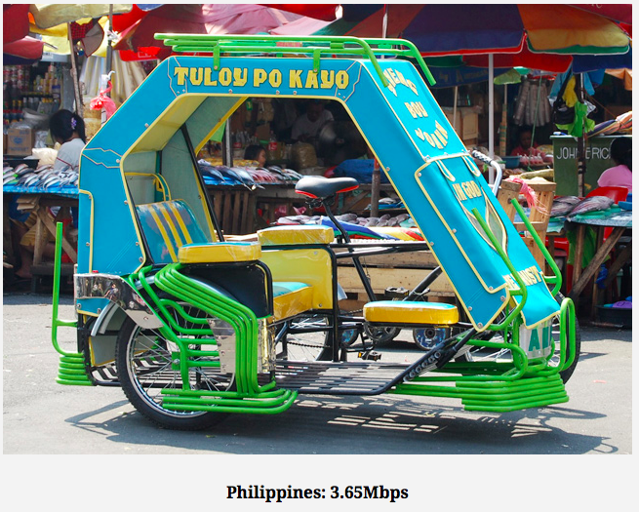

Slide 26
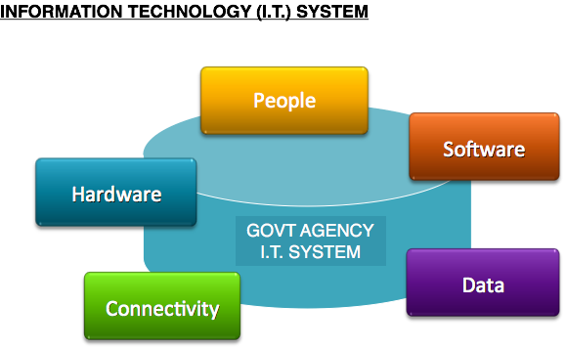
Information System

Slide 27
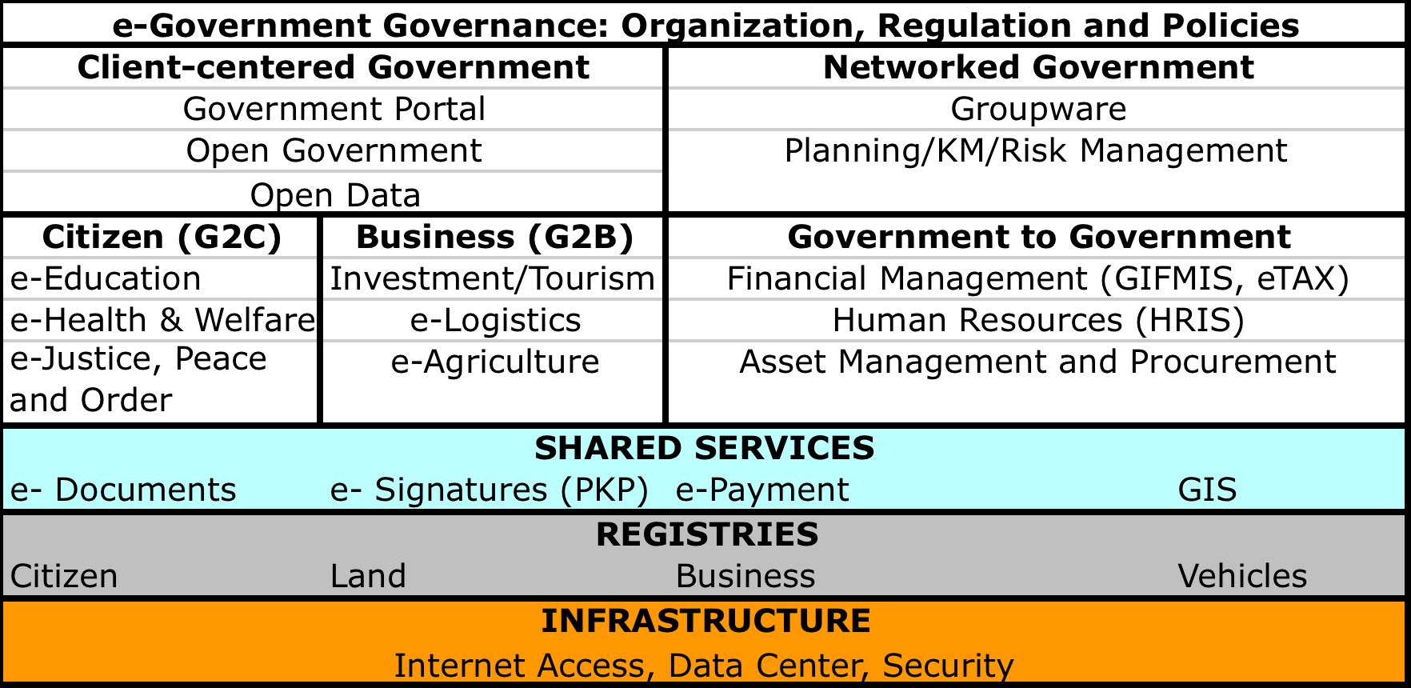
Building blocks of e-government (source: e-Government masterplan)

Slide 28
PART 3 Trends: EXAMPLES OF ICT SYSTEMS IN USE FOR DRM
ICTs in Disaster Prevention & Mitigation
ICTs in Disaster Preparedness
ICTs in Disaster Response
ICTs for Disaster Recovery

Slide 29
Disaster prevention & mitigation
PROJECT NOAH (Nationwide Operational Assessment of Hazards) :
a government multidisciplinary research unit .
It seeks to assist the country in disaster risk reduction and management, climate change adaptation and mitigation efforts by undertaking advanced disaster science research and comprehensive and multidisciplinary assessment of hazards.

Slide 30
Disaster prevention & mitigation
PROJECT NOAH (Nationwide Operational Assessment of Hazards) :
Hydromet Sensors Development
DREAM-LIDAR 3-D mapping Project
Flood NET- Flood Modeling Project
Hazards Information Media
Enhancing Geo-Hazards Mapping through LIDAR
Doppler System Development
Landslide Sensors Development Project
Storm Surge Inundation Mapping Project.
Weather Information – Integration for System Enhancement (WISE)

Slide 31
Project NOAH

Slide 32
Flood hazard map (sourcE: Nababaha.com)
Notes:
The flood hazards depicted in this site are the product of flood simulations using Flo2d, a Federal Emergency Management Agency (FEMA)-approved flood routing application software. The inundation maps were simulated using rainfall delivered by tropical storm Ondoy on 26 September 2009 over 3 arc second topography from the Shuttle Radar Topography Mission (SRTM). The rainfall event is considered as an extreme event that can generate floods with a 100-150 year return period.
These hazard maps are indicative inundation maps for large flood events and useful only for knowing where not to be during extremely heavy rainfall. For local governments, these flood hazard maps can be used for localized emergency response (i.e. evacuation and access routes, road closures, siting of key rescue facilities) and for urban planning. It should not be used for insurance and bank appraisal purposes.

Slide 33
Relevance
These hazard maps are indicative inundation maps for large flood events and useful only for knowing where not to be during extremely heavy rainfall.
For local governments, flood hazard maps can be used for localized emergency response (i.e. evacuation and access routes, road closures, siting of key rescue facilities) and for urban planning.
.

Slide 34
Achievements
By undertaking advanced disaster science research and comprehensive and multidisciplinary assessment of hazards.
The result was the development of accessible tools which were relevant for local government units, community leaders, policy makers, planners, and families to prevent and mitigate disasters.

Slide 35
Achievements
NOAH helped raise Filipinos' awareness of natural hazards
Increased awareness of disaster risk is key to cultivating a culture of preparedness and reducing the catastrophic impacts of extreme hazard events.

Slide 36
Disaster preparedness
OCD’s Disaster Information for National Awareness (Project DINA)
PAGASA’s Weather Forecasting Systems
Rainfall Warning
Thunderstorm Warning
Early Warning and Monitoring for Flood
National cellphone broadcast system (Mobile Technology)

Slide 37
PROJECT DINA

Slide 38
Weather forecasting

Slide 39
Weather forecasting

Slide 40
Weather forecasting

Slide 41
Weather forecasting
Example:
National Cell Broadcast System

Slide 42
DISASTER RESPONSE
NDRRMC’s Intelligent Operations Center (IOC)
Government Emergency Communication Program
Resilient Networks and Reconfigurable IS for Rapidly Deployable Disaster Response
NDRMO National Text Blast System
eBayanihan Project
“Batingaw” Mobile App

Slide 43
DISASTER RECOVERY
Faith
eMPATHY
Igov Phil

Slide 44
ICT Resilience in the Philippines : Challenges
ICT Resilience is still weak but is a work in progress
ICT resilience is recognized but is not a priority
ICTs operate within an external environment that consists of poor physical infrastructure such as power and energy sources; and a weakly implemented legal and regulatory framework.

Slide 45
ICT Resilience in the Philippines : Challenges
Technical challenges abound such as but not limited to
Interorperability
Weak to non existent government continuity plans
Technical and administrative redundancies are few
Weak Planning : Infra and information standards need to be updated and implemented
In Systems (system cyber security)
Develop system back-up
Cyber security teams

Slide 46
recommendations
Prioritizing and Investing in Resilience
Integrate Resiliency in Policy
Integrate resilience ( for ICT) a critical factor in the Governance equation
Develop an ICT plan for DRM that is integrated and coordinated with existing DRM and climate change policies and programs as well as with economic and development plans.
Strengthen the enabling policy environment for enhancing ICT in DRM and Climate Change Adaptation
Allocate budgetary resources for DRM and CCA

Slide 47
recommendations
Build resiliency by improving the capacity to use ICT for DRM and CCA
Invest in Appropriate Technology
Train gov’t personnel, citizens and communities
Building resiliency in DRM for critical Infrastructure (power, telecommunications)
Develop government continuity plans
Provide redundancies
Revisit infra and information standards
In Systems (system cyber security)
Develop system back-up
Cyber security teams

Slide 48
recommendations
Invest in and increase programs focused on capacity-building in the use of ICT for disaster risk management and climate change adaptation
Promote stronger public-private partnerships in the sharing of information and ICT resources, to help facilitate better coordination during disasters.
Use ICTs to engage citizens
For education and preparedness
For better mobilization; participation
For transparency and accountability (in rehab)

Slide 49
recommendations
Engage and strengthen local, regional and international collaboration for disaster risk management and climate change adaptation
Focus on fostering sharing of information and DRM resources.
Focus on strengthening collaboration and building capacity
Local Governments units (LGUs) should take the lead in improving DRM collaboration among themselves and with national government, private sector and regional and international governance institutions.

Slide 50
recommendations
Engage and strengthen bilateral, regional and international collaboration for disaster risk management and climate change adaptation
Focus on fostering sharing of information and DRM resources region wide.

Slide 51
THANK YOU

